Slide 1
Indoor Tracking System
Product Development Laboratory
Submitted By:
1. Sikakollu N V S K Prasanth(116cs0213)
2. Uttam Singh(116cs0238)

Slide 2
Contents
Introduction
Motivation
Objective
Hardware & Algorithms Used
Implementation & Analysis
Result
Conclusion

Slide 3
Introduction
Indoor Localization is a fundamental service for various location based applications.
Main challenges of indoor tracking system is the limitation of technologies available
The available technologies have their own assets and drawbacks,
Various Indoor Tracking Systems include:
Using IMU .
Using Wi-Fi Fingerprinting .
Using Bluetooth fingerprinting .

Slide 4
Motivation
The developed technology of today has presented the Global Positioning System (GPS) as the best of the localization systems.
But the GPS systems fails to localize in indoors due to 3 major reasons :
High attenuation of microwave radiations through concrete walls which weakens the signals.
It works only when the device with GPS architecture and the satellite are in Line Of Sight(LOS).
It has very low precision.
So for indoors, we need to go for other alternatives.

Slide 5
Objective:
To track a person inside a large building
Focus:
Integration of low cost IMU to improve system’s positioning update
Provide 2D localization estimates

Slide 6
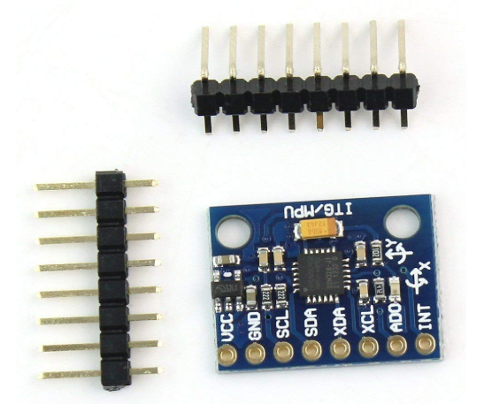
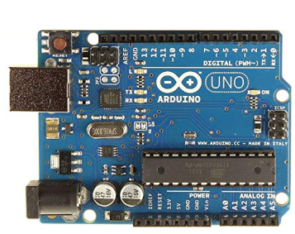
Hardware used
Inertial Measurement Unit(IMU):
GY521 MPU 6050
3-axis gyro + accelerometer module
2. Arduino Board:
UNO R3 AT MEGA 328p

Slide 7
Algorithms used:
Hardware algorithm:
The MPU 6050 is a 6 DOF (degrees of freedom) or a six-axis IMU sensor, consisting of two parts – 3 axis Accelerometer and 3 axis Gyroscope, thereby providing 6 outputs.
An accelerometer works on the principle of the piezoelectric effect.
Gyroscopes work on the principle of Coriolis acceleration.

Slide 8


Software algorithms:
Kalman filter:
Acceleration and angular rates observation of 3 axial IMU sensors are required to achieve high updated two dimensional positioning.
For the derivation of system’s complete state, the method of Dead Reckoning was applied.

Slide 9
Kalman filter Contd..
IMU observations are highly accurate but the solution provided by method of dead reckoning is not long term stable.
As we go on predicting the values of velocity and position, due to sensor drift and non-linearity of integration, the error accumulates to a significant level .
So we require a noise filter algorithm, in this case we used the extended Kalman filter.
The principle of this operation is to take observations of
external distances to one or more reference points into account.

Slide 10
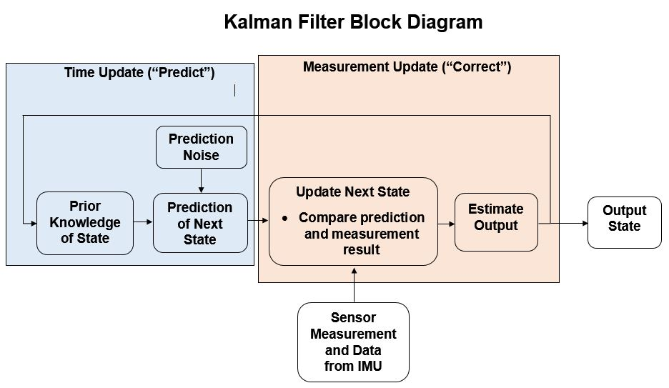

Slide 11
AHRS Algorithm
Attitude and Heading Reference System
An algorithm that provides the complete orientation of the sensor with respect to a navigation frame.
Aim of AHRS algorithm is to combine the information obtained from accelerometers and gyroscopes to obtain the orientation.
Conceptually divided into two blocks:
Orientation from gyroscopes
Orientation from accelerometers

Slide 12
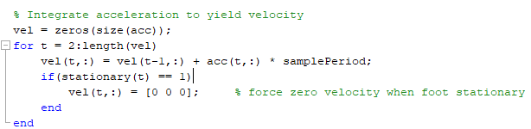
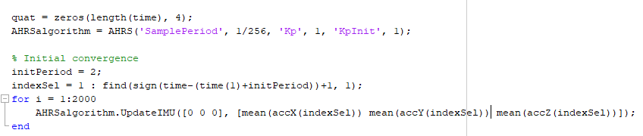

Slide 13
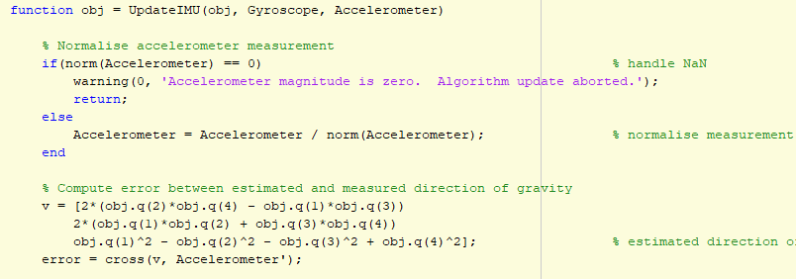

Slide 14
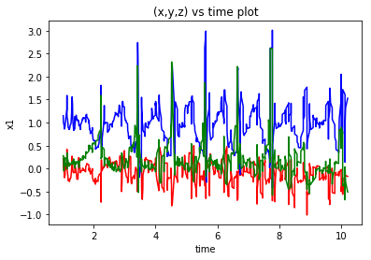
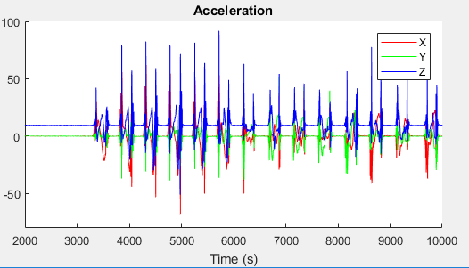
RESULTS

Slide 15
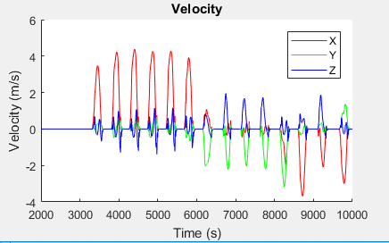
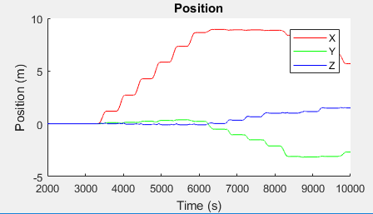

Slide 16
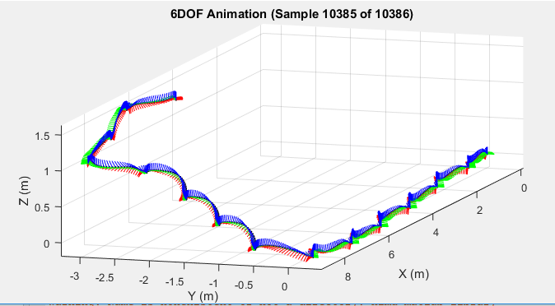
Final Tracking of a person climbing stairs

Slide 17
Applications of Indoor Human Tracking System
Indoor Human Tracking system has many applications
Areas of defence
To guide a person in a large building
To help and guide people inside a building and rescuing them at times of fire breakdown.

Slide 18
Thank you

